Slide 1
MODULE – 2
Multithreading in Java
MODULE – 4
Distributed Programming with servlets and JSP

Slide 2
Syllabus
Servlet – Web application basics, Architecture and challenges of web application, Introduction to servlets, Servlet life-cycle, Developing and Deploying servlets, creation and compilation of servlets, Introduction to Tomcat, Handling HTTP requests and responses, Handling HTTP GET and POST requests.
JSP – Introduction to JSP, Creation and Test of simple JSP, JSP scripting constructs, JSP predefined variables, JSP directives, Database operations with JSP.

Slide 3
Contents
Web application basics, Architecture and challenges of web application
Introduction to servlets
Servlet life-cycle
Developing and Deploying servlets
Creation and Compilation of servlets
Introduction to Tomcat
Handling HTTP requests and responses
Handling HTTP GET and POST requests.

Slide 4
Servlets Introduction

Slide 5
Servlets Introduction
A servlet is a java class that extends an application hosted on a web server.
Handles the HTTP request-response process (for our purposes)
Provides a component base architecture for web development, using the Java Platform
Alternative to CGI scripting and platform specific server side applications.

Slide 6
Servlets
Processing and/or storing data submitted by an HTML form.
Providing dynamic content, e.g. returning the results of a database query to the client.
Managing state information on top of the stateless HTTP, e.g. for an online shopping cart system which manages shopping carts for many concurrent customers and maps every request to the right customer.

Slide 7
Servlets
Servlets provide the middle tier in a three or multi-tier system.
Servlets provide logic and/or traffic control for requests/response to the server.
Servlets allow web developers to remove code from the client and place the logic on the server.

Slide 8
Servlets
Servlets are not run in the same sense as applets and applications.
Since they extend a web server, they require a servlet container to function.
A servlet container is a part of a web server or application server that provides the network services over which request and response are sent.
Contains and manages the servlets through there lifecycle.

Slide 9
Web Container/Servlet engine
J2EE Container
Java Classes
Servlets
Browser
Web Server
Deployment Descriptor is used to configure web applications that are hosted in the App Server.
Deployment Descriptor
web.xml

Slide 10
Web Application Directory Structure
Application Root (htdocs/wwwroot)
WEB-INF/web.xml
WEB-INF/classes
Compiled servlet classes and other utility classes
WEB-INF/lib
Any required third party jars
All J2EE compliant App Servers require this directory structure

Slide 11
Servlet Interface
This is a contract between the servlet and the web container.
Guarantees that all containers can communicate with a servlet.
public void init(ServletConfig)
public void service(request, response)
public void destroy()
public ServletConfig getServletConfig()
public String getServletInfo()

Slide 12
The Servlet API
Two packages contain the classes and interfaces that are required to build servlets.
These are javax.servlet and javax.servlet .http. They constitute the Servlet API.

Slide 13
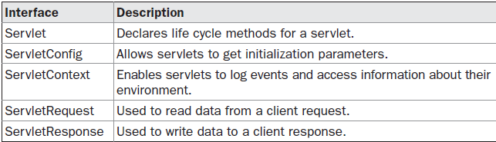
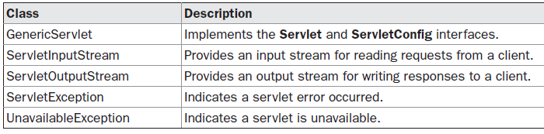
The javax.servlet Package

Slide 14
HttpServlet
Abstract class that extends GenericServlet
Provides additional methods that are called by the service() method automatically.
Both methods throw ServletException and IOException
Methods of most concern:
Protected void doGet(HttpServletRequest, HttpServletResponse)
protected void doPost(HttpServletRequest, HttpServletResponse)

Slide 15
Servlet Life Cycle
Instantiation – web container creates an instance.
Initialization – container calls the instance’s init().
Service – if container has request, then it calls the service() method
Destroy – before reclaiming the memory (destroying the servlet), the container calls the destroy() method.
Unavailable – instance is destroyed and marked for GC.

Slide 16
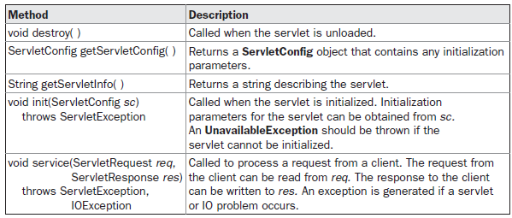
The Servlet Interface

Slide 17
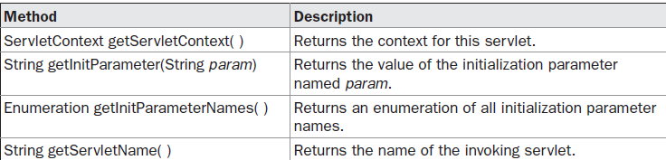
ServletConfig Interface
The ServletConfig interface allows a servlet to obtain configuration data when it is loaded.
The methods declared by this interface are summarized here:

Slide 18
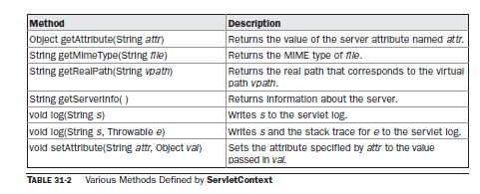
ServletContext Interface
The ServletContext interface enables servlets to obtain information about their environment

Slide 19
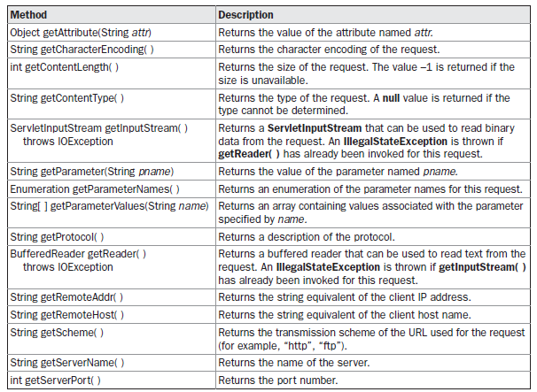
ServletRequest Interface

Slide 20
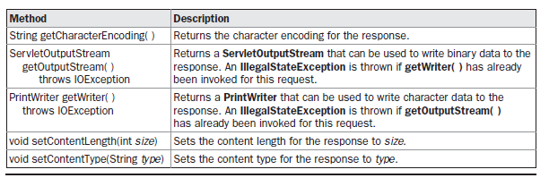
ServletResponse Interface

Slide 21
The GenericServlet Class
The GenericServlet class provides implementations of the basic life cycle methods for a servlet.
GenericServlet implements the Servlet and ServletConfig interfaces. In addition, a method to append a string to the server log file is available. The signatures of this method are shown here:
void log(String s)
void log(String s, Throwable e)
Here, s is the string to be appended to the log, and e is an exception that occurred.

Slide 22
Reading Servlet Parameters
The ServletRequest interface includes methods that allow you to read the names and values of parameters that are included in a client request.
We will develop a servlet that illustrates their use. The example contains two files.
A web page is defined in PostParameters.htm,
A servlet is defined in PostParametersServlet.java.

Slide 23
UnamePasswordServlet.html
<html>
<body bgcolor=aabbcc>
<form action=http://localhost:8000/myProject/UnamePasswordServlet method="post">
NAME:<input type="text" name="name"><br>
PASSWORD:<input type="password" name="pwd"><br>
<input type="submit">
<input type="reset”></form>
</body>
</html>

Slide 24
UnamePasswordServlet.java
import javax.servlet.*;
import java.io.*;
public class UnamePasswordServlet extends GenericServlet
{
public void service(ServletRequest req,ServletResponse res) {
Try {
PrintWriter pw=res.getWriter();
res.setContentType("text/html");
String name=req.getParameter("name");
String pwd=req.getParameter("pwd");
pw.println("<b>Name="+name+"<br>Password="+pwd);
pw.close();
}
catch(Exception excep) {
System.out.println(excep.getMessage());
}
}
}

Slide 25
Handling HTTP Requests and Responses
The HttpServlet class provides specialized methods that handle the various types of HTTP requests.
These methods are doDelete( ), doGet( ), doHead( ), doOptions( ), doPost( ), doPut( ), and doTrace( ).
However, the GET and POST requests are commonly used when handling form input. Therefore, this section presents examples of these cases.

Slide 26
Handling HTTP GET Requests
Here we will develop a servlet that handles an HTTP GET request.
The servlet is invoked when a form on a web page is submitted.
The example contains two files.
A web page is defined in ColorGet.htm,
servlet is defined in ColorGetServlet.java.
The HTML source code for ColorGet.htm defines a form that contains a select element and a submit button.
Notice that the action parameter of the form tag specifies a URL.
The URL identifies a servlet to process the HTTP GET request.

Slide 27
ColorGet.html
<html>
<body>
<center>
<form name="Form1“ action="http://localhost:8080/servlets-examples/servlet/ColorGetServlet">
<B>Color:</B>
<select name="color" size="1"<option value="Red">Red</option>
<option value="Green">Green</option>
<option value="Blue">Blue</option>
</select>
<br><br>
<input type=submit value="Submit">
</form>
</body>
</html>

Slide 28
ColorGetServlet.java
import java.io.*;
import javax.servlet.*;
import javax.servlet.http.*;
public class ColorGetServlet extends HttpServlet
{
public void doGet(HttpServletRequest request,HttpServletResponse response) throws ServletException, IOException {
String color = request.getParameter("color");
response.setContentType("text/html");
PrintWriter pw = response.getWriter();
pw.println("<B>The selected color is: ");
pw.println(color);
pw.close(); } }

Slide 29
Handling HTTP POST Requests
The DoPost() method is used to handling POST request.
POST is used to send data to a server to create/update a resource.
POST requests are never cached
POST requests do not remain in the browser history
POST requests cannot be bookmarked
POST requests have no restrictions on data length

Slide 30
Handling HTTP POST Requests
<html>
<body>
<center>
<form name="Form1“ method="post"
action="http://localhost:8080/servlets-examples/servlet/AddCookieServlet">
<B>Enter a value for MyCookie:</B>
<input type=textbox name="data" size=25 value=“ ">
<input type=submit value="Submit">
</form></body> </html>

Slide 31
Handling HTTP POST Requests
import java.io.*;
import javax.servlet.*;
import javax.servlet.http.*;
public class AddCookieServlet extends HttpServlet {
public void doPost(HttpServletRequest request, HttpServletResponse response)
throws ServletException, IOException {
// Get parameter from HTTP request.
String data = request.getParameter("data");
// Create cookie.
Cookie cookie = new Cookie("MyCookie", data);
// Add cookie to HTTP response.
response.addCookie(cookie);
// Write output to browser.
response.setContentType("text/html");
PrintWriter pw = response.getWriter();
pw.println("<B>MyCookie has been set to");
pw.println(data);
pw.close();
} }

Slide 32
Server Side Development
Java Server Pages
(JSP)
by
Impa B H
Asst.Prof
Dept of CSE

Slide 33
Topics
JSP Fundamentals
JSP Scripting Elements
JSP Implicit Objects
JSP Directives
JSP Actions
Tag Libraries
Notes:
Prevention: locks at doors, window bars, walls round the property
Detection: stolen items are missing, burglar alarms, closed circuit TV
Reaction: call the police, replace stolen items, make an insurance claim …
Prevention: encrypt your orders, rely on the merchant to perform checks on the caller, don’t use the Internet (?) …
Detection: an unauthorized transaction appears on your credit card statement
Reaction: complain, ask for a new card number, etc.

Slide 34
Java Server Pages (JSP) Fundamentals
Java Server Pages are HTML pages embedded with snippets of Java code.
It is an inverse of a Java Servlet
JSP and Servlets are key components of the Java Enterprise Edition.
Four different elements are used in constructing JSPs
Scripting Elements
Implicit Objects
Directives
Actions
Notes:
Prevention: locks at doors, window bars, walls round the property
Detection: stolen items are missing, burglar alarms, closed circuit TV
Reaction: call the police, replace stolen items, make an insurance claim …
Prevention: encrypt your orders, rely on the merchant to perform checks on the caller, don’t use the Internet (?) …
Detection: an unauthorized transaction appears on your credit card statement
Reaction: complain, ask for a new card number, etc.

Slide 35
JSP Life Cycle
The life cycle of a JSP page can be divided into the following phase:
Translation Phase
Compilation Phase
Initialization Phase
Execution Phase
Destruction(Cleanup) Phase

Slide 36
Java Server Pages (JSP) Architecture
In translation phase JSP page is compiled into a servlet
called JSP Page Implementation class
In execution phase the compliled JSP is processed
Receive
Request
HTTP Server
JSP Container
Page Compiler Servlet
JSP Servlet
Current?
No
Parse JSP
Yes
JSP Servlet
Loaded?
Generate JSP
Servlet Source
Yes
No
Load Servlet
Compile JSP
Servlet
JSP Page Servlet
Generate
Response
Send
Response
Notes:
Prevention: locks at doors, window bars, walls round the property
Detection: stolen items are missing, burglar alarms, closed circuit TV
Reaction: call the police, replace stolen items, make an insurance claim …
Prevention: encrypt your orders, rely on the merchant to perform checks on the caller, don’t use the Internet (?) …
Detection: an unauthorized transaction appears on your credit card statement
Reaction: complain, ask for a new card number, etc.

Slide 37
Scripting Elements Types
There are three kinds of scripting elements
Expressions
Scriplets
Declarations
Notes:
Prevention: locks at doors, window bars, walls round the property
Detection: stolen items are missing, burglar alarms, closed circuit TV
Reaction: call the police, replace stolen items, make an insurance claim …
Prevention: encrypt your orders, rely on the merchant to perform checks on the caller, don’t use the Internet (?) …
Detection: an unauthorized transaction appears on your credit card statement
Reaction: complain, ask for a new card number, etc.

Slide 38
Expressions Basics
Used to write dynamic content back to the browser.
If the output of expression is Java primitive the value is printed back to the browser
If the output is an object then the result of calling toString on the object is output to the browser
Embedded in <%= and %> delimiters
Example:
<%=“Fred”+ “ “ + “Flintstone %>
prints “Fred Flintstone” to the browser
<%=Math.sqrt(100)%>
prints 10 to the browser
Notes:
Prevention: locks at doors, window bars, walls round the property
Detection: stolen items are missing, burglar alarms, closed circuit TV
Reaction: call the police, replace stolen items, make an insurance claim …
Prevention: encrypt your orders, rely on the merchant to perform checks on the caller, don’t use the Internet (?) …
Detection: an unauthorized transaction appears on your credit card statement
Reaction: complain, ask for a new card number, etc.

Slide 39
Scriptlets Basics
Used to embed java code in JSP pages.
Inserts one to many lines of Java code
Embedded in <% and %> delimiters
Example:
<%
int x = 5;
int y = 7;
int z = x + y;
%>
Notes:
Prevention: locks at doors, window bars, walls round the property
Detection: stolen items are missing, burglar alarms, closed circuit TV
Reaction: call the police, replace stolen items, make an insurance claim …
Prevention: encrypt your orders, rely on the merchant to perform checks on the caller, don’t use the Internet (?) …
Detection: an unauthorized transaction appears on your credit card statement
Reaction: complain, ask for a new card number, etc.

Slide 40
Declarations Basics
Declarations are used to define methods & instance variables
Do not produce any output that is sent to client
Embedded in <%! and %> delimiters
Example:
<%!
Public void jspDestroy() {
System.out.println(“JSP Destroyed”);
}
Public void jspInit() {
System.out.println(“JSP Loaded”);
}
int myVar = 123;
%>
The functions and variables defined are available to the JSP Page as well as to the servlet in which it is compiled
Notes:
Prevention: locks at doors, window bars, walls round the property
Detection: stolen items are missing, burglar alarms, closed circuit TV
Reaction: call the police, replace stolen items, make an insurance claim …
Prevention: encrypt your orders, rely on the merchant to perform checks on the caller, don’t use the Internet (?) …
Detection: an unauthorized transaction appears on your credit card statement
Reaction: complain, ask for a new card number, etc.

Slide 41
Java Implicit Objects List
request: Reference to the current request
response: Response to the request
session: session associated woth current request
application: Servlet context to which a page belongs
pageContext: Object to access request, response, session and application associated with a page
config: Servlet configuration for the page
out: Object that writes to the response output stream
page: instance of the page implementation class (this)
exception: Available with JSP pages which are error pages
Notes:
Prevention: locks at doors, window bars, walls round the property
Detection: stolen items are missing, burglar alarms, closed circuit TV
Reaction: call the police, replace stolen items, make an insurance claim …
Prevention: encrypt your orders, rely on the merchant to perform checks on the caller, don’t use the Internet (?) …
Detection: an unauthorized transaction appears on your credit card statement
Reaction: complain, ask for a new card number, etc.

Slide 42
Java Implicit Objects Scope
Implicit objects provide access to server side objects
e.g. request, response, session etc.
There are four scopes of the objects
Page: Objects can only be accessed in the page where they have created.
Request: Objects can be accessed within all pages that serve the current request.
(Including the pages that are forwarded to and included in the original jsp page)
Session: Objects can be accessed within the JSP pages for which the objects are defined that belong to the same session.
Application: Objects can be accessed by all JSP pages in a given context
Notes:
Prevention: locks at doors, window bars, walls round the property
Detection: stolen items are missing, burglar alarms, closed circuit TV
Reaction: call the police, replace stolen items, make an insurance claim …
Prevention: encrypt your orders, rely on the merchant to perform checks on the caller, don’t use the Internet (?) …
Detection: an unauthorized transaction appears on your credit card statement
Reaction: complain, ask for a new card number, etc.

Slide 43
Java Implicit Objects Example
<html>
<head>
<title>Implicit Objects</title>
</head>
<body style="font-family:verdana;font-size:10pt">
<p>
Using Request parameters...<br>
<b>Name:</b> <%= request.getParameter("name") %>
</p>
<p>
<% out.println("This is printed using the out implicit variable"); %>
</p>
<p>
Storing a string to the session...<br>
<% session.setAttribute("name", "Meeraj"); %>
Retrieving the string from session...<br>
<b>Name:</b> <%= session.getAttribute("name") %>
</p>
<p>
Storing a string to the application...<br>
<% application.setAttribute("name", "Meeraj"); %>
Retrieving the string from application...<br>
<b>Name:</b>
<%= application.getAttribute("name") %>
</p>
<p>
Storing a string to the page context...<br>
<% pageContext.setAttribute("name", "Meeraj"); %>
Retrieving the string from page context...</br>
<b>Name:</b>
<%= pageContext.getAttribute("name") %>
</p>
</body>
</html>
Notes:
Potential Damages:
1. Change orders placed by the client (Instead of 500 widgets he can make the order 50,000 widgets)
2. Change meeting venues to send people on wild goose chases

Slide 44
Directives Basics & Types
Messages sent to the JSP container
Aids the container in page translation
Used for
Importing tag libraries
Import required classes
Set output buffering options
Include content from external files
The jsp specification defines three directives
Page: provder information about page, such as scripting language that is used, content type, or buffer size
Include – used to include the content of external files
Taglib – used to import custom actions defined in tag libraries
Notes:
Potential Damages:
1. Change orders placed by the client (Instead of 500 widgets he can make the order 50,000 widgets)
2. Change meeting venues to send people on wild goose chases

Slide 45
Page Directives Basics & Types
Page directive sets page properties used during translation
JSP Page can have any number of directives
Import directive can only occur once
Embedded in <%@ and %> delimiters
Different directives are
Language: (Default Java) Defines server side scripting language (e.g. java)
Extends: Declares the class which the servlet compiled from JSP needs to extend
Import: Declares the packages and classes that need to be imported for using in the java code (comma separated list)
Session: (Default true) Boolean which says if the session implicit variable is allowed or not
Buffer: defines buffer size of the jsp in kilobytes (if set to none no buffering is done)
Notes:
Potential Damages:
1. Change orders placed by the client (Instead of 500 widgets he can make the order 50,000 widgets)
2. Change meeting venues to send people on wild goose chases

Slide 46
Page Directives Types con’t.
Different directives are (cont’d.)
autoFlush:When true the buffer is flushed when max buffer size is reached (if set to false an exception is thrown when buffer exceeds the limit)
isThreadSafe: (default true) If false the compiled servlet implements SingleThreadModel interface
Info: String returned by the getServletInfo() of the compiled servlet
errorPage: Defines the relative URI of web resource to which the response should be forwarded in case of an exception
contentType: (Default text/html) Defines MIME type for the output response
isErrorPage: True for JSP pages that are defined as error pages
pageEncoding: Defines the character encoding for the jsp page
Notes:
Potential Damages:
1. Change orders placed by the client (Instead of 500 widgets he can make the order 50,000 widgets)
2. Change meeting venues to send people on wild goose chases

Slide 47
Page Directives Example
<%@
page language=“java”
buffer=“10kb”
autoflush=“true”
errorPage=“/error.jsp”
import=“java.util.*, javax.sql.RowSet”
%>
Notes:
Potential Damages:
1. Change orders placed by the client (Instead of 500 widgets he can make the order 50,000 widgets)
2. Change meeting venues to send people on wild goose chases

Slide 48
Include Directive Basics
Used to insert template text and JSP code during the translation phase.
The content of the included file specified by the directive is included in the including JSP page
Example
<%@ include file=“included.jsp” %>
Notes:
Potential Damages:
1. Change orders placed by the client (Instead of 500 widgets he can make the order 50,000 widgets)
2. Change meeting venues to send people on wild goose chases

Slide 49
JSP Actions Basics & Types
Processed during the request processing phase.
As opposed to JSP directives which are processed during translation
Standard actions should be supported by J2EE compliant web servers
Custom actions can be created using tag libraries
The different actions are
Include action
Forward action
Param action
useBean action
getProperty action
setProperty action
plugIn action
Notes:
Potential Damages:
1. Change orders placed by the client (Instead of 500 widgets he can make the order 50,000 widgets)
2. Change meeting venues to send people on wild goose chases

Slide 50
JSP Actions Include
Include action used for including resources in a JSP page
Include directive includes resources in a JSP page at translation time
Include action includes response of a resource into the response of the JSP page
Same as including resources using RequestDispatcher interface
Changes in the included resource reflected while accessing the page.
Normally used for including dynamic resources
Example
<jsp:include page=“inlcudedPage.jsp”>
Includes the the output of includedPage.jsp into the page where this is included.
Notes:
Potential Damages:
1. Change orders placed by the client (Instead of 500 widgets he can make the order 50,000 widgets)
2. Change meeting venues to send people on wild goose chases

Slide 51
JSP Actions Forward
Forwards the response to other web specification resources
Same as forwarding to resources using RequestDispatcher interface
Forwarded only when content is not committed to other web application resources
Otherwise an IllegalStateException is thrown
Can be avoided by setting a high buffer size for the forwarding jsp page
Example
<jsp:forward page=“Forwarded.html”>
Forwards the request to Forwarded.html
Notes:
Potential Damages:
1. Change orders placed by the client (Instead of 500 widgets he can make the order 50,000 widgets)
2. Change meeting venues to send people on wild goose chases

Slide 52
JSP Actions Param
Used in conjunction with Include & Forward actions to include additional request parameters to the included or forwarded resource
Example
<jsp:forward page=“Param2.jsp”>
<jsp:param name=“FirstName” value=“Sanjay”>
</jsp:forward>
This will result in the forwarded resource having an additional parameter FirstName with a value of Sanjay
Notes:
Potential Damages:
1. Change orders placed by the client (Instead of 500 widgets he can make the order 50,000 widgets)
2. Change meeting venues to send people on wild goose chases

Slide 53
JSP Actions get/setProperty
getProperty is used in conjunction with useBean to get property values of the bean defined by the useBean action
Example (getProperty)
<jsp:getProperty name=“myBean” property=“firstName” />
Name corresponds to the id value in the useBean
Property refers to the name of the bean property
setProperty is used to set bean properties
Example (setProperty)
<jsp:setProperty name=“myBean” property=“firstName” value=“Sanjay”/>
Sets the name property of myBean to SanjayExample (setProperty)
<jsp:setProperty name=“myBean” property=“firstName” param=“fname”/>
Sets the name property of myBean to the request parameter fname
<jsp:setProperty name=“myBean” property=“*”>
Sets property to the corresponding value in request
Notes:
Potential Damages:
1. Change orders placed by the client (Instead of 500 widgets he can make the order 50,000 widgets)
2. Change meeting venues to send people on wild goose chases

Slide 54
JSP Actions plugIn
Enables the JSP container to render appropriate HTML (based on the browser type) to:
Initiate the download of the Java plugin
Execution of the specified applet or bean
plugIn standard action allows the applet to be embedded in a browser neutral fashion
Example
<jsp: plugin type=“applet” code=“MyApplet.class” codebase=“/”>
<jsp:params>
<jsp:param name=“myParam” value=“122”/>
</jsp:params>
<jsp:fallback><b>Unable to load applet</b></jsp:fallback>
</jsp:plugin>
Notes:
Potential Damages:
1. Change orders placed by the client (Instead of 500 widgets he can make the order 50,000 widgets)
2. Change meeting venues to send people on wild goose chases

Slide 55
Thank you

